Slide 1
Benchmarking in Clustering
K Medoids, Student T Model and DBSCAN
By
Qian Meng
November, 2020
Notes:
Good afternoon, everyone. I’m going to talk about the project Randy and I were working on recently for course 252.

Slide 2
Outlines
Purpose & Background
Clustering Methods (DBSCAN)
Optimal Number of Clusters
4 experiments:
I）High Dim II) Outliers III) Clusters IV) Correlation
Summary

Slide 3
Purpose & Background
Purpose:
Benchmark clustering methods by performing experiments
Using silhouette index(SI) and adjusted random index(ARI).
Clustering methods :
K-medoids, Student-t model,
DBSCAN (density-based spatial clustering of applications with noise)
Datasets:
Real data (USPS MNIST handwritten digits) (-> test high dimension)
Simulated Contaminated data (-> test outliers, number of clusters and correlation).

Slide 4
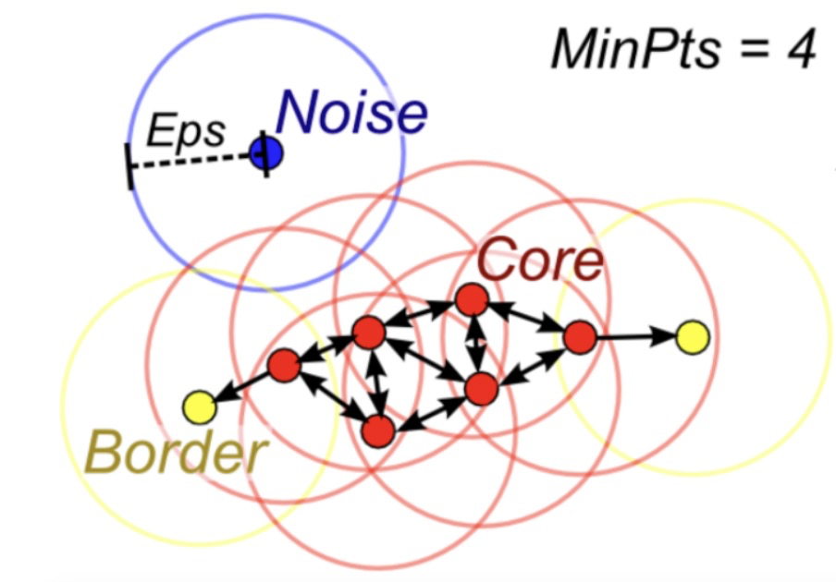
Clustering Methods
K-medoids: creates clusters by using a data point in the data set as the centroid.
Student t model : is an EM algorithm which maximizes the likelihood of t distribution to model data.
DBSCAN(density-based spatial clustering of applications with noise)
: groups points that are close to each other based on a distance measurement (Euclidean distance) and a minimum number of points. It also marks as outliers the points that are in low-density regions.
** All three methods are supposed to be resilient to outliers.

Slide 5
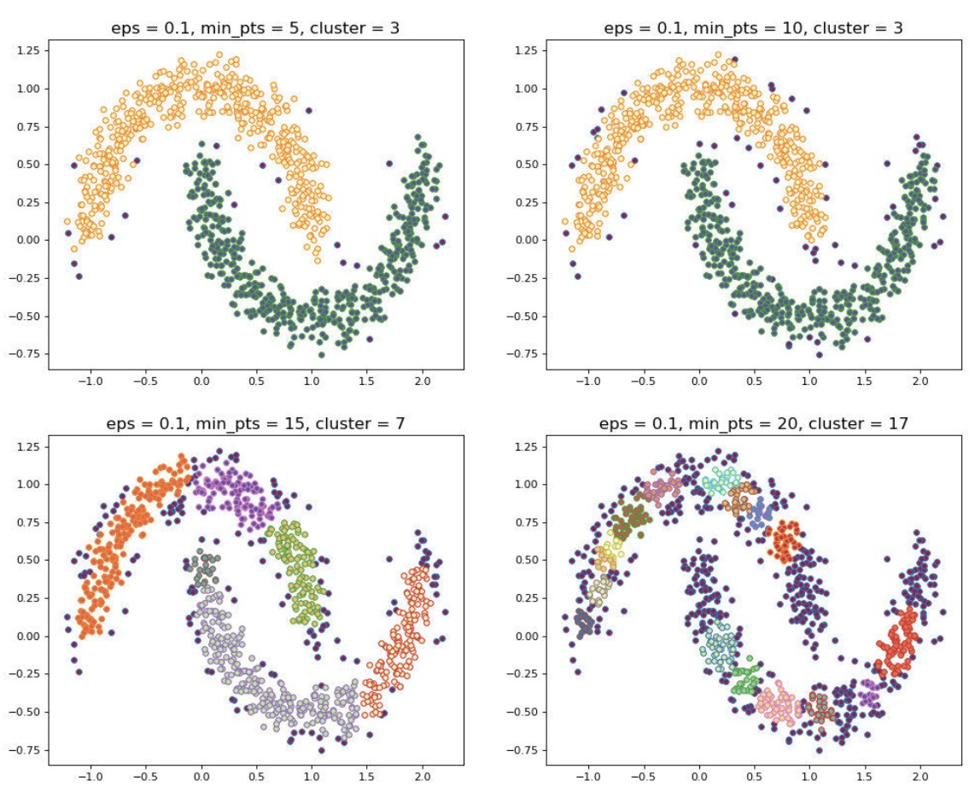
DBSCAN (Density-based Spatial clustering of applications with noise)
2 parameters: epsilon (radius around the point ) and k (minimum neighbor points)
2 properties: needn’t initiate the number of clusters
determine outliers (using the distance of k nearest neighbors.)
In R
(fpc package)
dbscan(data, eps, MinPts = k, ...)
Use knn to pick epsilon
kNN(x, k, query = NULL, sort = TRUE, search = "kdtree", …)
Notes:
According to its definition,
a data matrix, a dist object or a kNN object.
knumber of neighbors to find.
DBSCAN is a clustering algorithm that only has two parameters which are and minimum neighbor points. Groups together points that are close to each other based on a distance measurement (Euclidean distance) and a minimum number of points.
Marks as outliers the points that are in low-density regions.
As spectral clustering, we learned in the last lecture , DBSCAN can be used to deal with nonconvex components.
The number of clusters are sensitive to parameters. Epsilon and k
密度不同，DBSCAN 表现不好
因为对于高维数据，传统的欧几里得密度定义不能很好处理它们。

Slide 6
How we choose Optimal Number of Clusters
K-medoids:
based on SI or ARI
Student t model:
based on the BIC.
DBSCAN:
computed by DBSCAN algorithm automated.

Slide 7
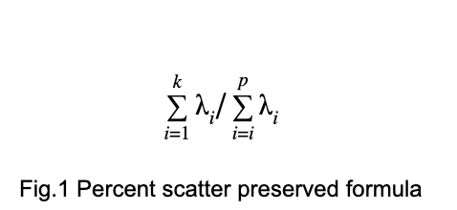
I）High Dimension
Raw Data : USPS MNIST handwritten digits (70,000x784 matrix, 10 clusters)
Limited by R, a smaller subset was used to do the experient.
Data set preserving 70% to 99% -> subspace dims = c(24,31,40,53,77,130,276)
PCA
ordered eigenvalues of the covariance matrix of the dataset.
p the number of total dimensions.
k is the number of dimensions in a lower dimensional plane.

Slide 8
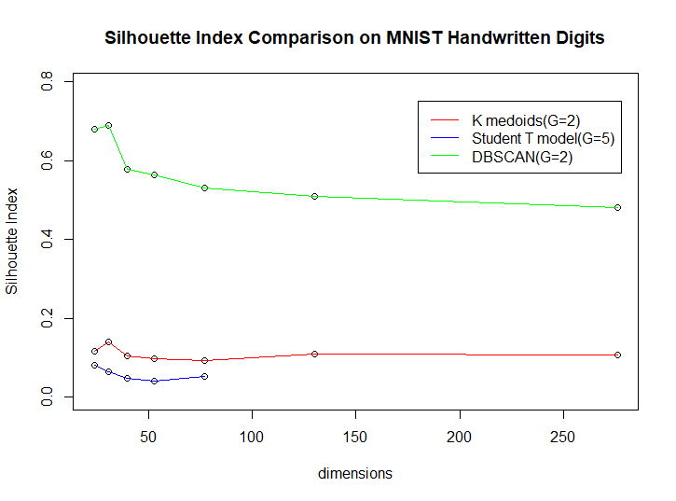
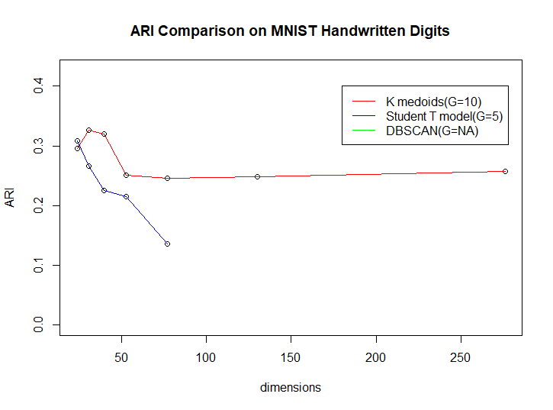
Models’ Performance(High Dim)
K-medoids was also able to pick out 10 clusters (the true number of labels).
DBSCAN considered most data points to be an outlier
(G are number of clusters found in the best model per method)
** All three methods performed poorly in high dimensions.

Slide 9
II) Outliers
Simulated Dataset: contaminated normal distribution
Cluster Number =5
Means: different between clusters
Variance = 100, 1000 ( low sig = 100, high sig = 1000)
Alpha = 0.05, 0.1,... , 0.3 ( the percent of ‘bad’ data points, high sig )
Outliers : ten times greater than the original variance.

Slide 10
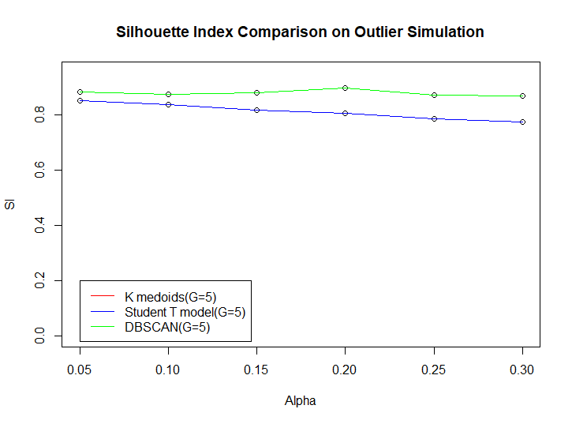
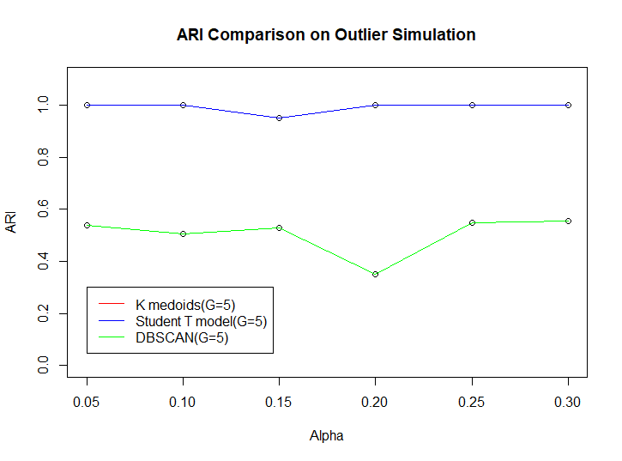
Models’ Performance(Outliers)
All three methods performed well with less or more outliers.
K-medoids line is overlap by Student T.
DBSCAN finds outliers and omits them from clusters

Slide 11
III) Number of Clusters
Simulated Dataset: contaminated normal distribution
Cluster Number =5,10,...,30
Variables Number =10
Means: different between clusters
Variance = 100 (for most points)
Alpha = 0.05 ( the percent of ‘bad’ data points, sig = 1000 )

Slide 12
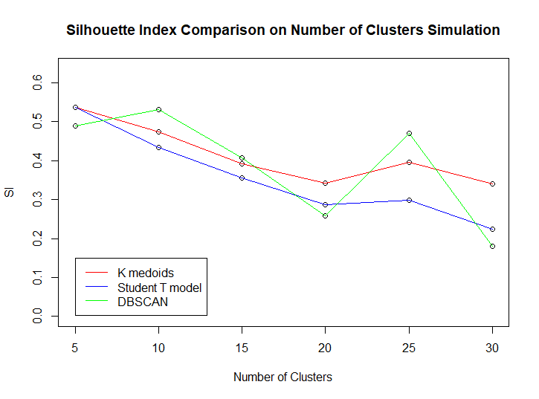
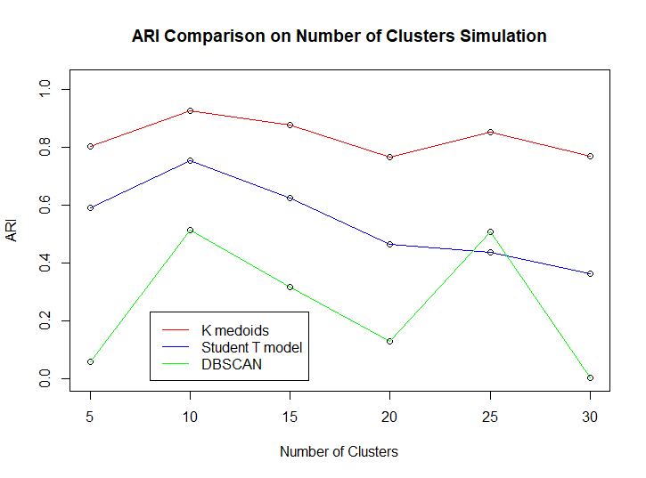
Models’ Performance (Cluster Number)
K medoids performed better than the student t. (no outliers, var stable)
Downward sloping pattern — the more classes, the worse the performance is.

Slide 13
IV) Correlation
Simulated Dataset: contaminated normal distribution
Cluster Number =5
Correlations = 0, 0.2,..., 1
Variance = 1
Means: different between clusters
Outliers : ten times greater than the original variance.

Slide 14
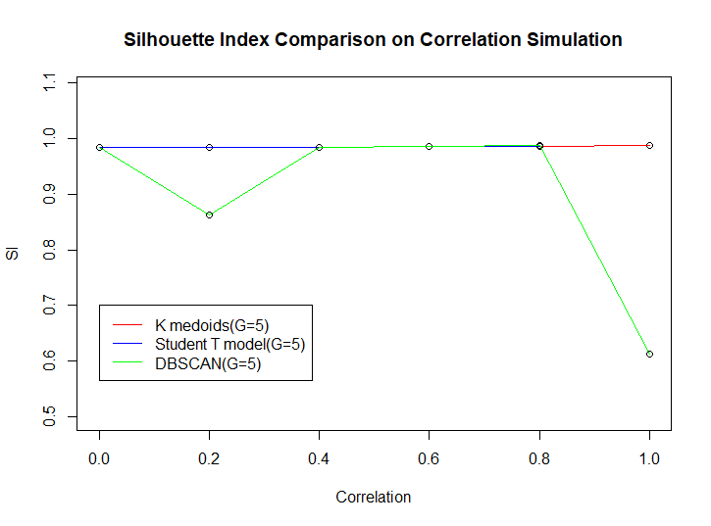
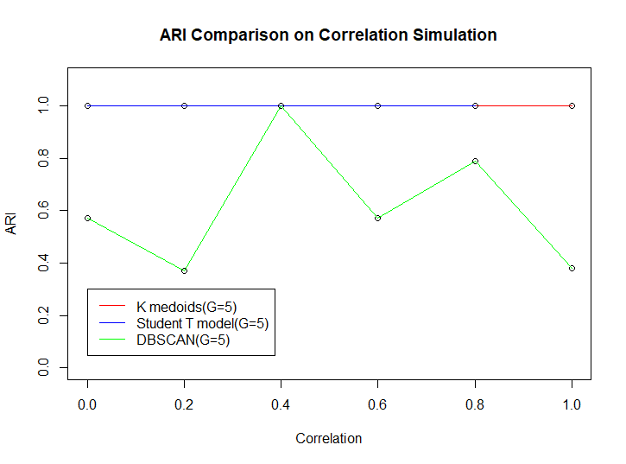
Models’ Performance(Correlation Far Clusters)
The SI and ARI values for k medoids and student t are close to 1 (not actually 1).
Student t model not converge when the correlation was 1.
DBSCAN looks for something circular, (not suit correlation).

Slide 15
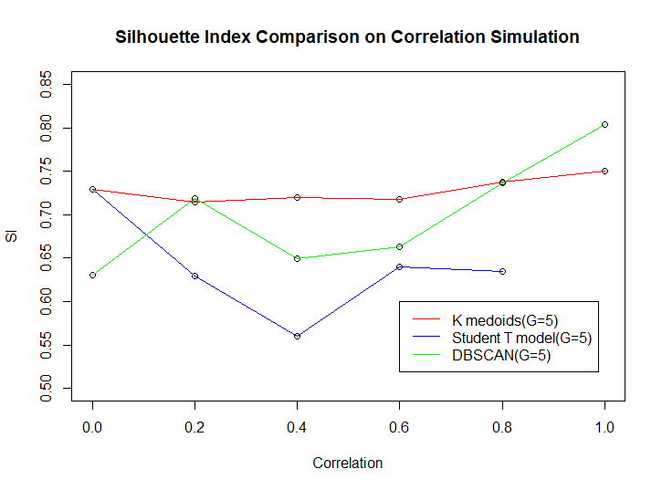
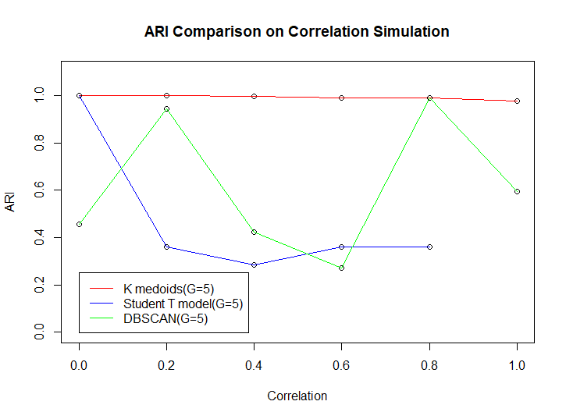
Models’ Performance(Correlation Close Clusters)

Slide 16
Summary
K medoids and student t model seems to be more similar to each other than DBSCAN.
K medoids and student t performed well with outliers and correlation but poorly with high dimensions.
DBSCAN performed well with high dimensions and outliers but poorly with correlation.
 | Dimensions | Outliers | Number of Clusters (more clusters) | Correlation
K Medoids | X | ✓ | X | ✓
Student T Model | X | ✓ | X | △
DBSCAN | △ | ✓ | X | X

Slide 17
Bibliography
[1] https://rdrr.io/cran/dbscan/man/kNN.html
[2] https://medium.com/@agarwalvibhor84/lets-cluster-data-points-using-dbscan

